Slide 1
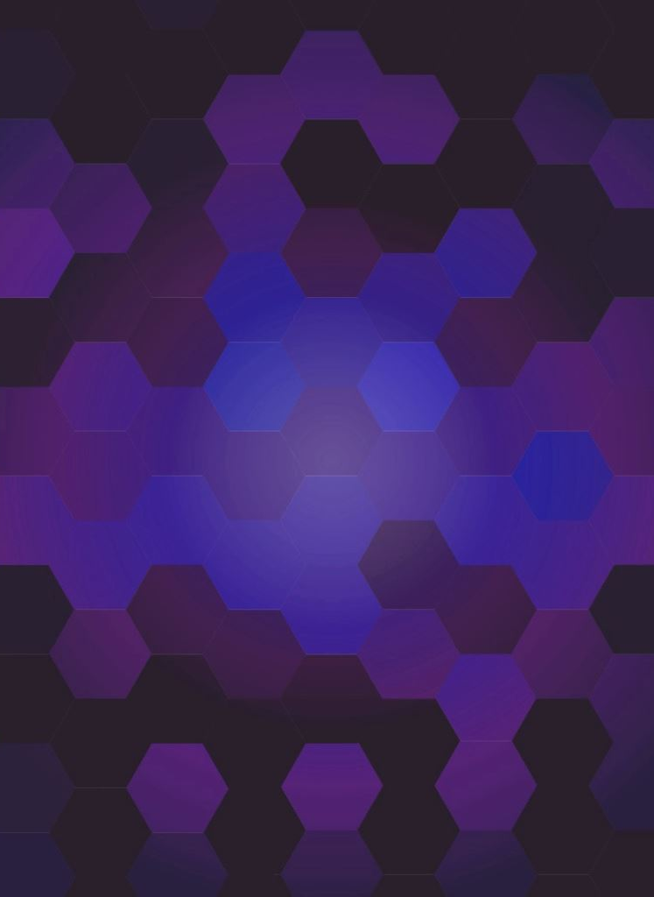
CSC492H5 Visual Elements of User Interface Design
Notes:
Notes:
Questions asked by Petersen:
How can these deliverables (Design Brief, Mood board, Button template, Mock-up) be applied to something like a company or start up?
- All of these incrementally become increasingly more refined and require more time/money commitment.
- Design Brief: Helps get employees on the same page about the vision and direction of the company.
- Mood board: Used to set the ambiance of the company both internally and for external stakeholders. Used in presentation backgrounds, and shit.
- Button template: A parallel can be drawn to company structure. So like we display all possible states of the button with text, this can resemble an org structure, who reports to who, or chain of command internally. This can also be given to a client depicting their chain of contacts.
- Mock-up: This is a prototype. Similar to in a company, this is used to as a more real prototype to get feedback from clients and stakeholders. Maybe point out some issues, potential use cases, or change in styling. Very similar to an agile approach to any company. Deliver quick and deliver often, rather than waiting to develop what you think is a perfect design.

Slide 2
Week 1: Introduction to UI Design
Topics covered:
What is a user interface (UI)?
Relationship of UI and UX
Roles in UI/UX
Interface conventions and considerations when designing
Approaches to Screen-based UI
Nox adopts a content-based UI approach.
Notes:
Week 1 was more getting familiar with the semantics and definitions.
Answered some basic questions such as what is a UI.
But the key things I learned here were what to consider when designing a UI. These included: - Real world knowledge, where you recognize what a digital button is because you’ve experienced them in real life.
Cause and Effect, where for every action, a user expects a reaction.
Seamlessness, where you want to minimize the number of clicks to achieve a common task.
There were a couple more, but you get the idea.
And ended off the week by discussing approaches to Screen-based Uis (template vs content based)
Since the goal of Nox is to prioritize functionality in a minimalist design, it will adopt a content-based UI approach.

Slide 3
Week 2: Formal elements of UI design
Topics covered:
Briefs
What is it? Who is it for? Where does it live?
Style Frames and Mood Boards
Look and feel
Components of Visual Design
Language, Shapes, Colour Pallet, Imagery, Typography, Icons
Notes:
This is when we got a little hands on and started going through the process of developing a UI BEFORE developing the actual UI.
We discussed what a brief is… which is a NON-VISUAL pre-design document that highlights the goals, constraints, platform, and the audience of the end-product.
Most design projects start with this and these are often defined by the client.
I made some samples for a dummy project and also made one for Nox. << Next Slide >>
We also discussed mood boards... Which are also part of a pre-design document. Its purpose is to provide some inspiration of the look feel the app should have.
Things like the colour pallet, imagery, and typography need to be included. << Next slide >>

Slide 4
Notes:
So there’s 3 parts to this:
A short description of your project idea
A tagline for your project
A description of the main activity or function of the app

Slide 5
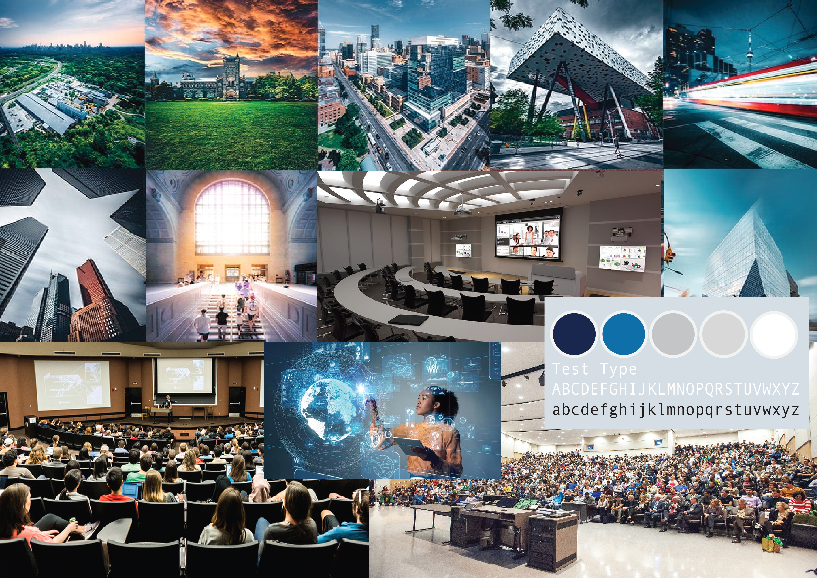
Notes:
Here is one for Nox:
The colour pallet includes some inspiration from UofT’s colours. And naturally the typography and imagery is meant to give a sense of sophistication, higher-education focus, larger classrooms.
Again, the goal of this is to envision the look and feel of the end-product.

Slide 6
Week 3: Active Elements of UI Design
Topics covered:
Static to Active UI
Relationship of UI and UX
Composing Interactions
Points of Interactions
Button and Non-button elements
Speed and Style
Composition and Structure
Notes:
Here we began introducing some UX aspects to our UI.
We began thinking about our active elements and how they would behave.
We also began thinking about the interactions of the app at a high-level. << Next Slide >>
We discussed Composing Interactions which went over the idea that the speed of a user interacting with a UI to get a job done, and the styling to make your UI idiosyncratic and engaging is a balancing game.
The main-focus here should be to make your interface fit your content.

Slide 7
A student would open the webapp, type in their session code and hit the “Join” button. The app would return the standard UI of 3 buttons with emotions on them along with a message field to pose a question to the lecturer.
A lecturer would open the webapp, create a session for their course and hit the “Create” button. The webapp would return a dashboard showing the number of students in the room, the session code, a rolling chat feed, and a graph depicting a live view of student’s comfort level with the material being presented.
Notes:
For example for Nox, we have 2 sets of interaction – A student and a Lecturer:
I won’t read that all out but in short,
For students, the interaction flow is the following: Input Session Code and hit join → then pose questions or Click the feedback buttons when necessary.
For lecturers, it is Click Login → Choose the course → Click Start Session → View results as they come in.
The goal here is to minimize the number of clicks to accomplish the objective. Want to reduce friction to not take away from the lecture itself.
<< Previous Slide >>

Slide 8
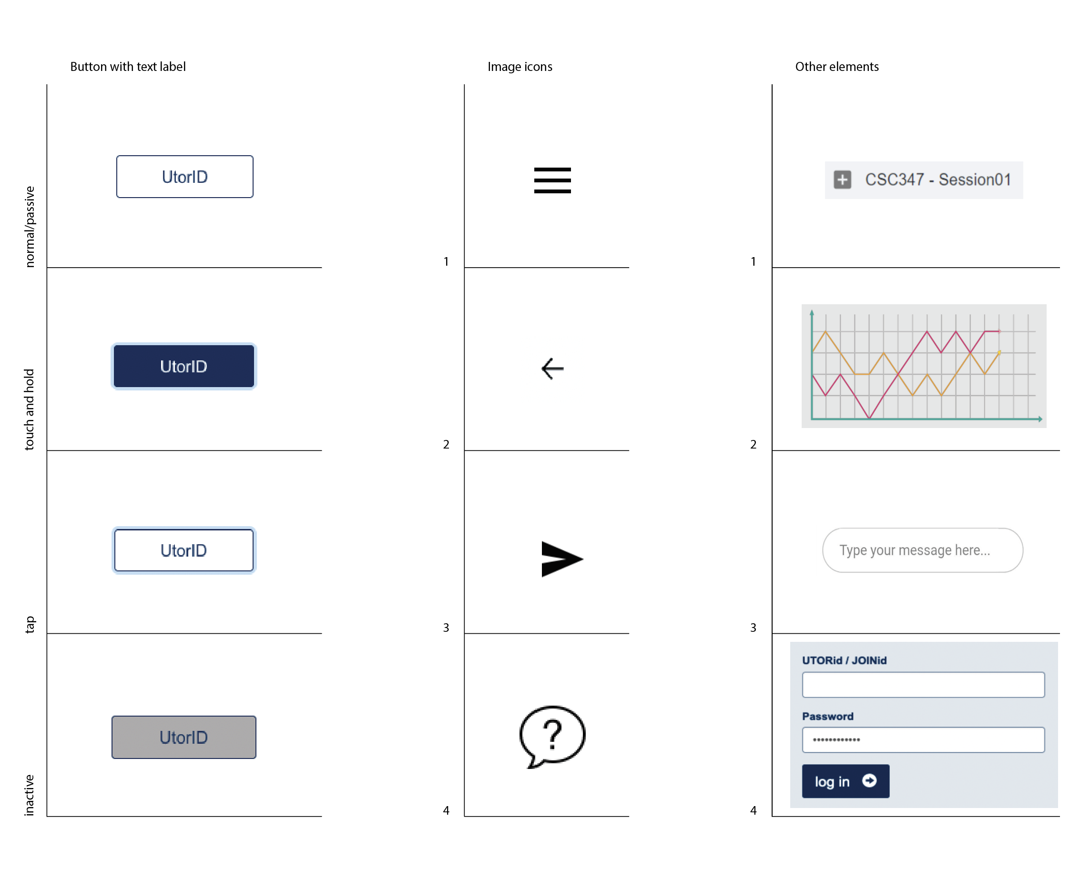
Notes:
This was the deliverable for Week 3, producing a collection of button and non-button visuals that fit with the theme of the product.

Slide 9
Week 4: Making a Whole from Many Parts
Topics covered:
Hierarchy and Composition:
What goes where? Why?
Structure and Grids
Components of a UI structure
Putting it all together
Notes:
We began combining these ideas from the previous weeks into a whole, finally creating a preliminary mock-up.
Began thinking about how the user will interact with the product. Answering questions such as:
What’s the first thing the user sees? In the case of Netflix for example: A ton of visually exciting movie posters. And in Nox, it would be the session ID page.
What’s the user’s first impression? Whats the first thing the user does? Etc.

Slide 10
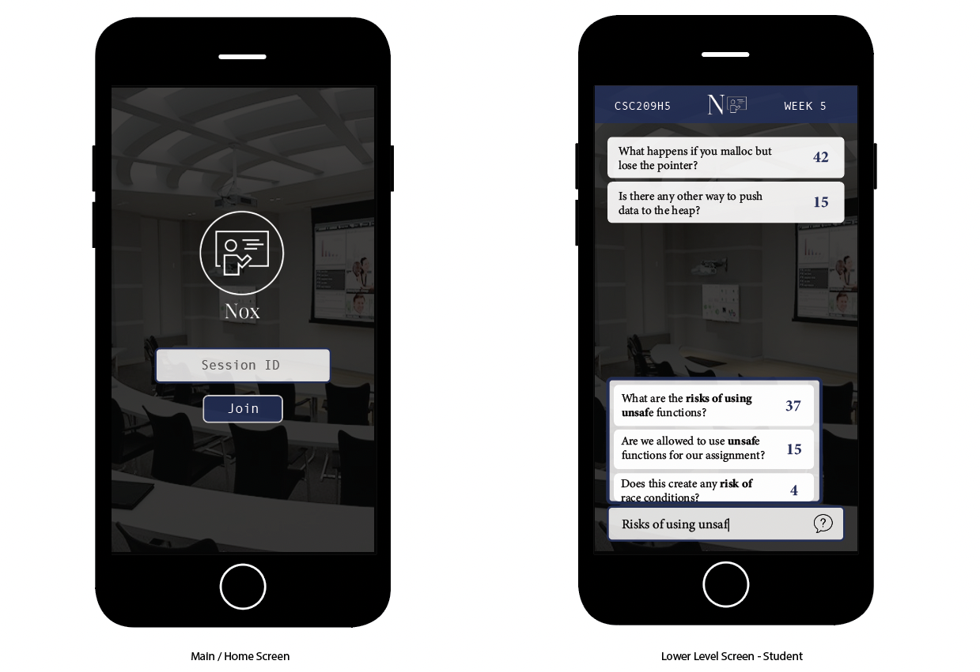
Notes:
Now the week 4 deliverable is where I fell a little short, I didn’t get a chance to give time to implement the preliminary UI of Nox.
So for now, here is the design I came up with for the dummy product I made as part of the course material. The product was called meat findr which helps you find certain types of meats in your area. This is for a niche market of meat connaseurs.
I will create a mockup for Nox shortly, which I’ll probably be building on it for the next course as well.

Slide 11
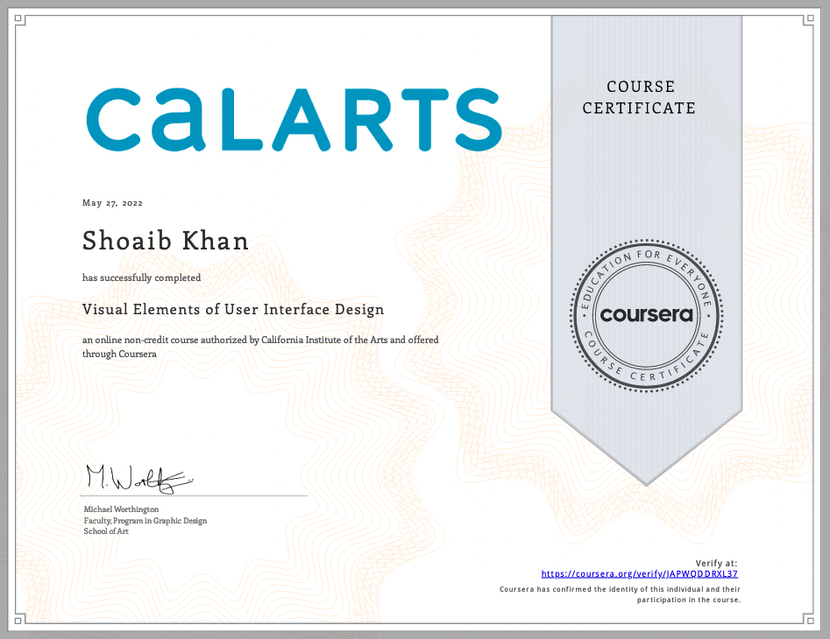
Notes:
But any who, that wraps up this course. Wohoo!
Honestly, initially when I was doing the mood board and stuff, I thought it was BS and just wanted to go straight to wireframing.
But going through this process, I found that it made it a lot easier to have some direction when designing the final UI mock-ups.
I will likely follow this approach for future projects as well.

